Slide 1



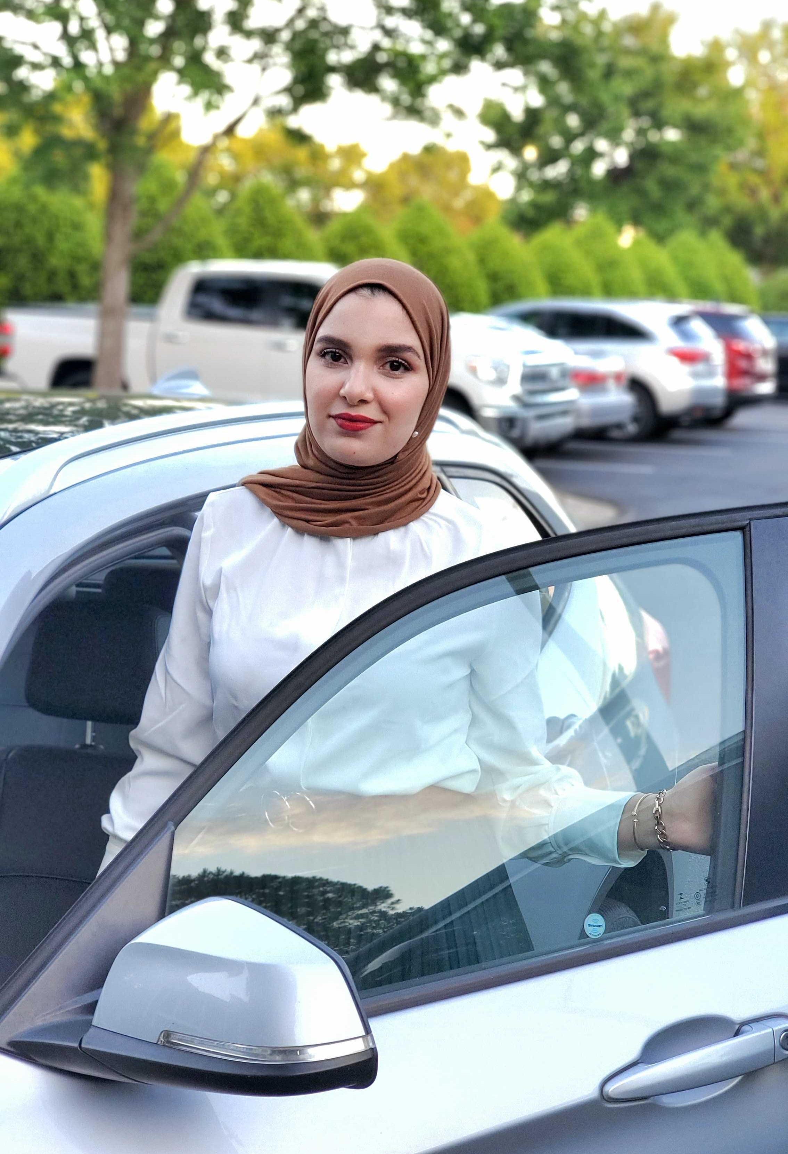


Slide 2



ELEVATOR PITCH:
Want to track repairs and services needed for all your cars? That’s a lot to add to your already busy calendar. Luckily, there is an easier way to keep track of everything. Car Dash will let you do just that and much more. Sign up now for free and maintain your vehicle services in tip-top shape

Slide 3
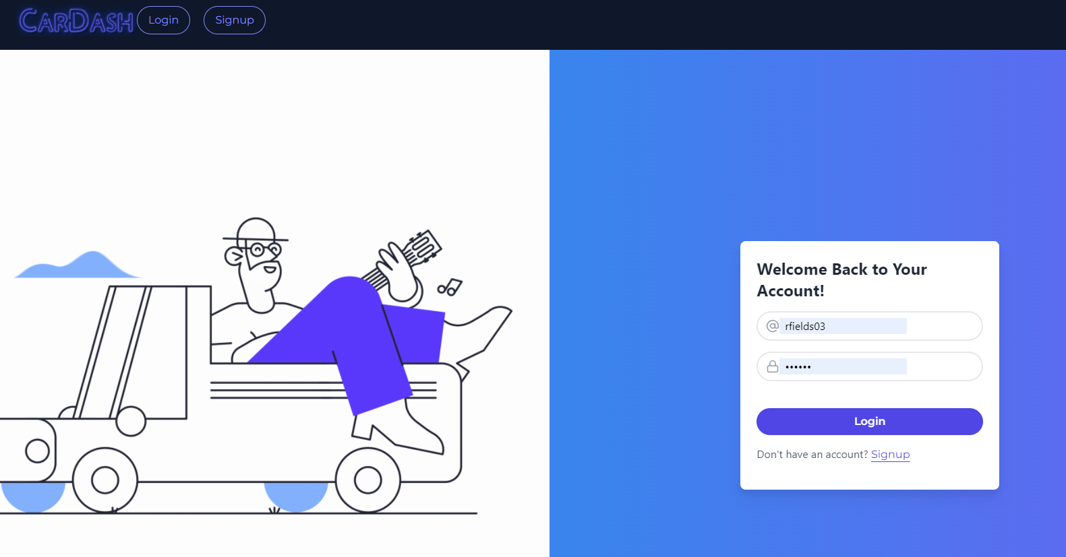
As a vehicle owner // I need all my car’s information on my phone or tablet //to have everything I need to keep my car running well.

Slide 4
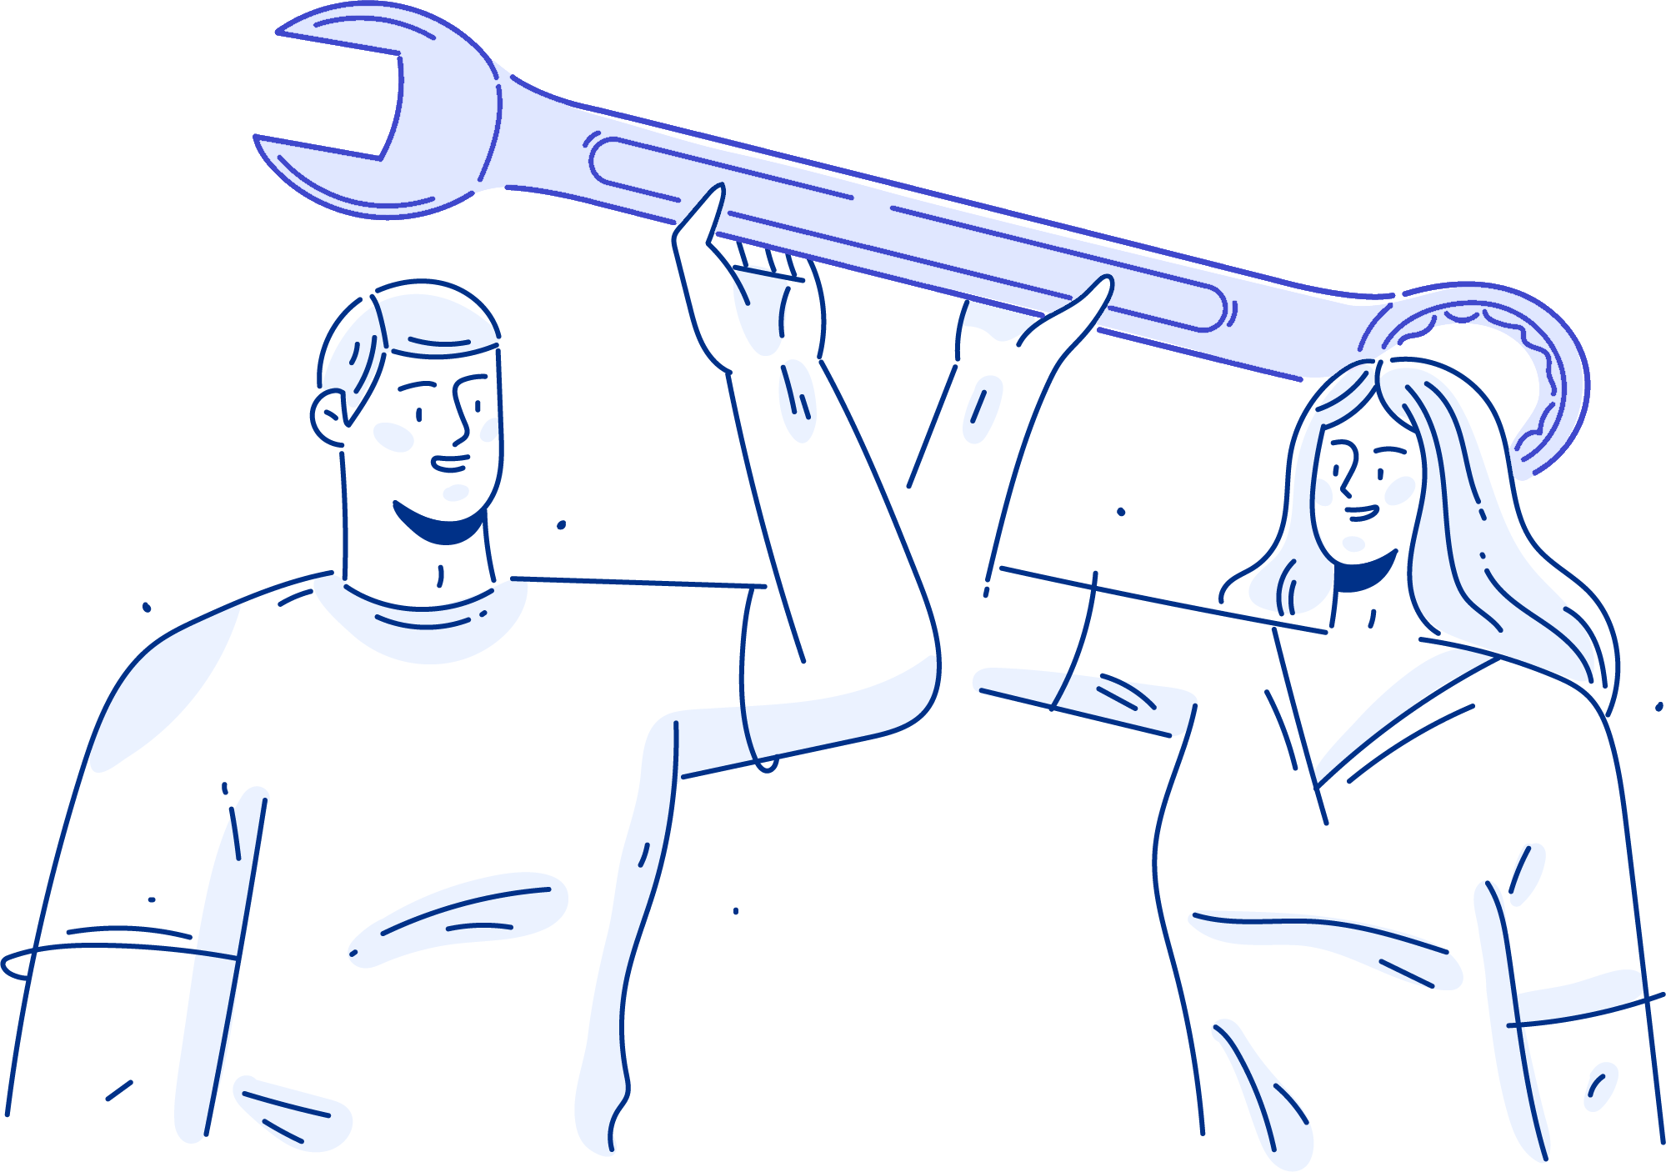
BACK-END
MONGO DB EXPRESS GRAPH QL APOLLO SERVER JWT ENCRYPTION

Slide 5

FRONT-END REACT REACT DOM REACT ROUTER JWT-DECODE GRAPH QL TAILWIND/CSS GRAPHIC DESIGN

Slide 6
DEMO

Slide 7
SUCCESSES CUSTOM DESIGN HARD WORK CONCEPT TO WEB COMMUNICATION
CHALLENGES GITHUB MERGING FORM INTEGRATION NAVIGATION UPLOAD IMAGE

Slide 8
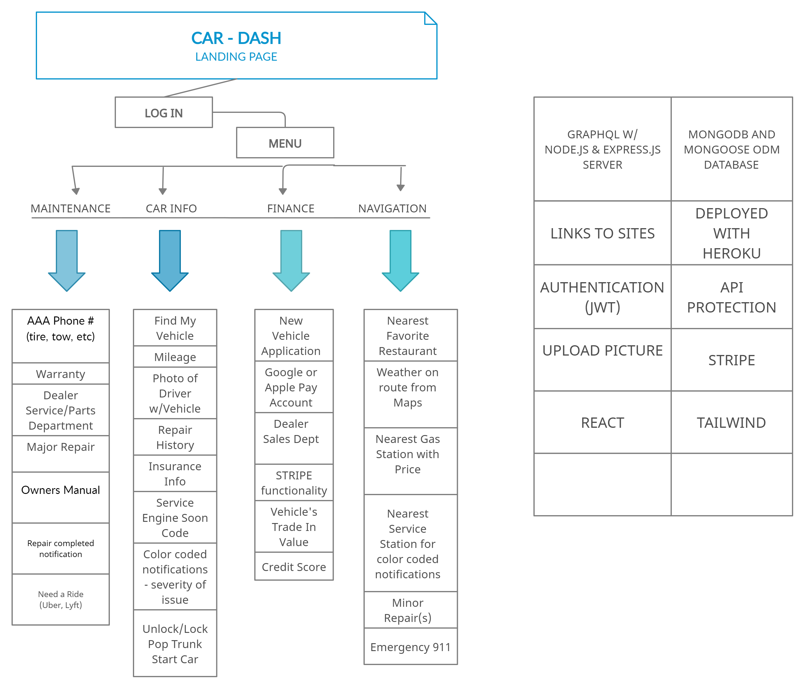
FUTURE DEVELOPMENT

